Slide 1
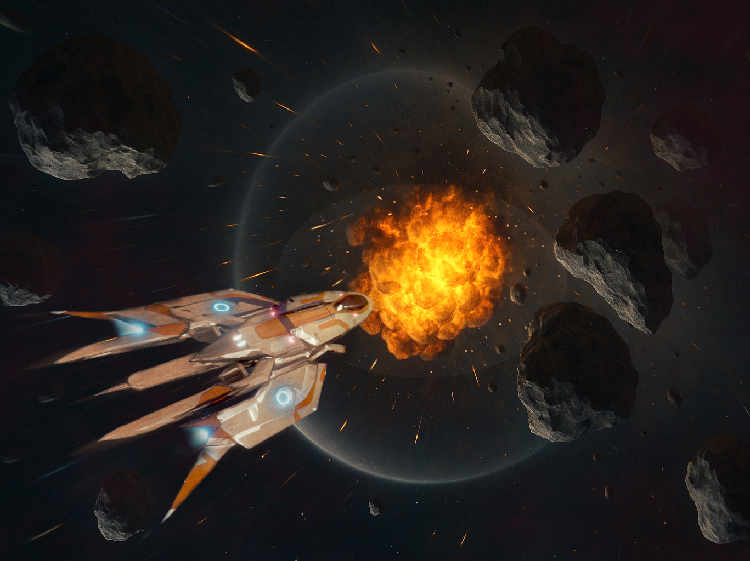
Dogfight AI-steroids
Reinforcement Learning for 2D Space Combat
Arye Mindell – CMSI 5998: AI Game Development

Slide 2
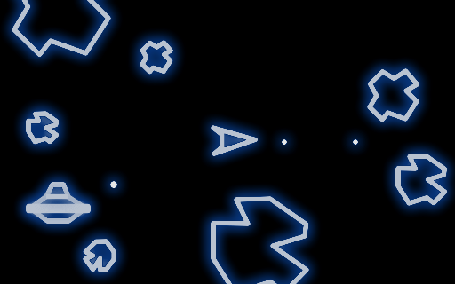
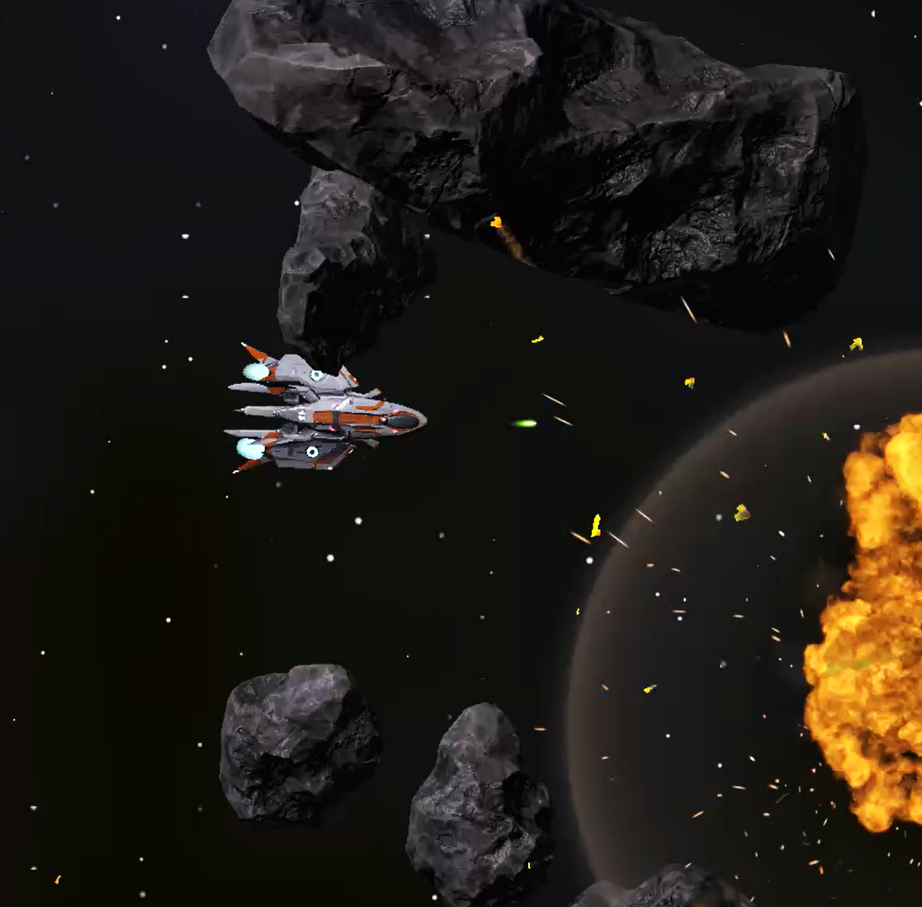
Project Proposal
F1 - New Weapon Types
Laser guns for precision combat
Homing missiles + lock‑on targeting
F2 - Health & Damage System
Hull + shield mechanics, physics‑based damage
F3 - 'Dummy' Enemy AI
Behavior Tree baseline for comparisons
F4 - RL Enemy Pilot
PPO‑trained continuous‑action agent
Experiment with Self-Play / BC

Slide 3
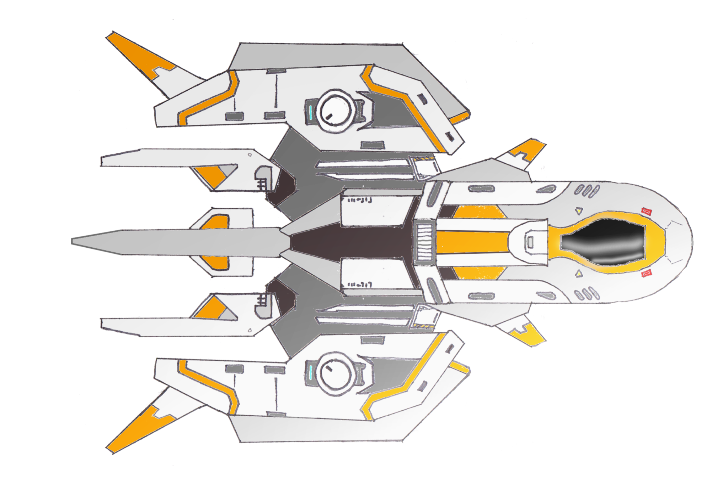
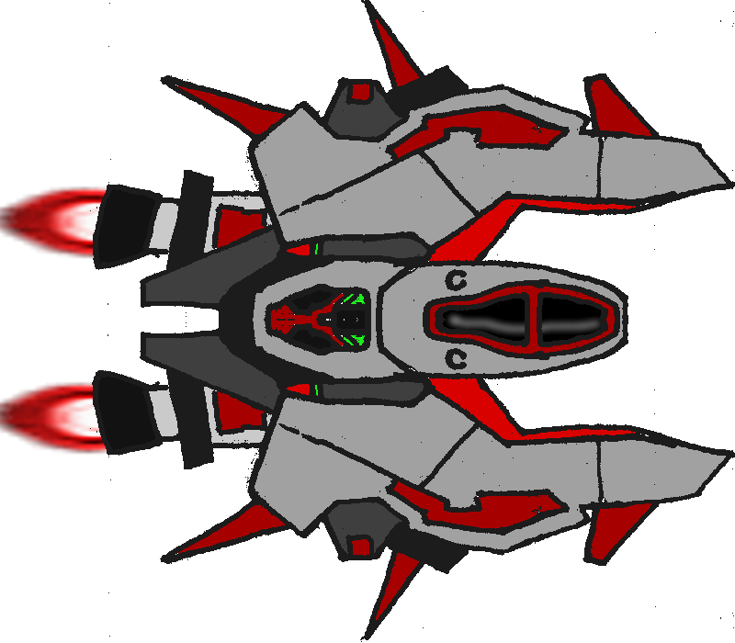
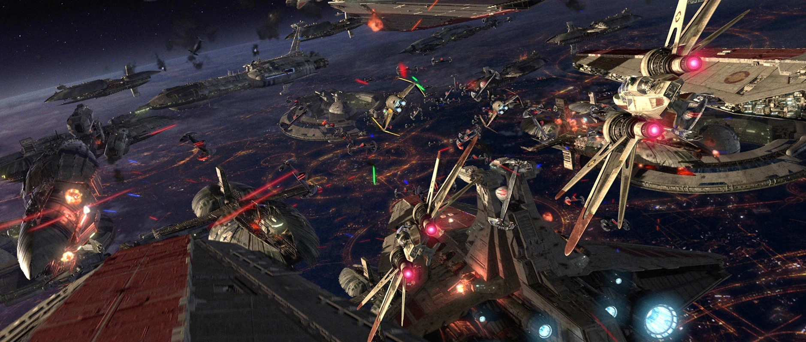
Personal Interest
Aerospace/Engineering/Sci-Fi
Academic Curiosity
Deep RL & control in physics‑heavy environments
Creative Passion
Music, Art, Graphic Design, Gaming
Portfolio Goal
Deep learning, project management, and research skills
Unity proficiency

Slide 4
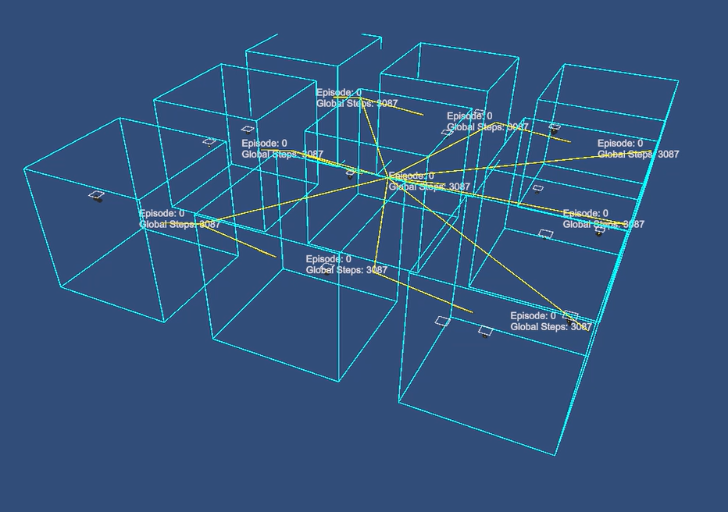
Implementation I
Modular Command Pattern
Player Input | Behavior Tree | RL Agent
Multi‑Arena RL Training
Parallel arenas = fast convergence
Initialize with BC → basic PPO curriculum
→ extended Self-Play
Physics & Systems Layer
Asteroid fragmentation, weapon subsystems, physics-based damage system

Slide 5
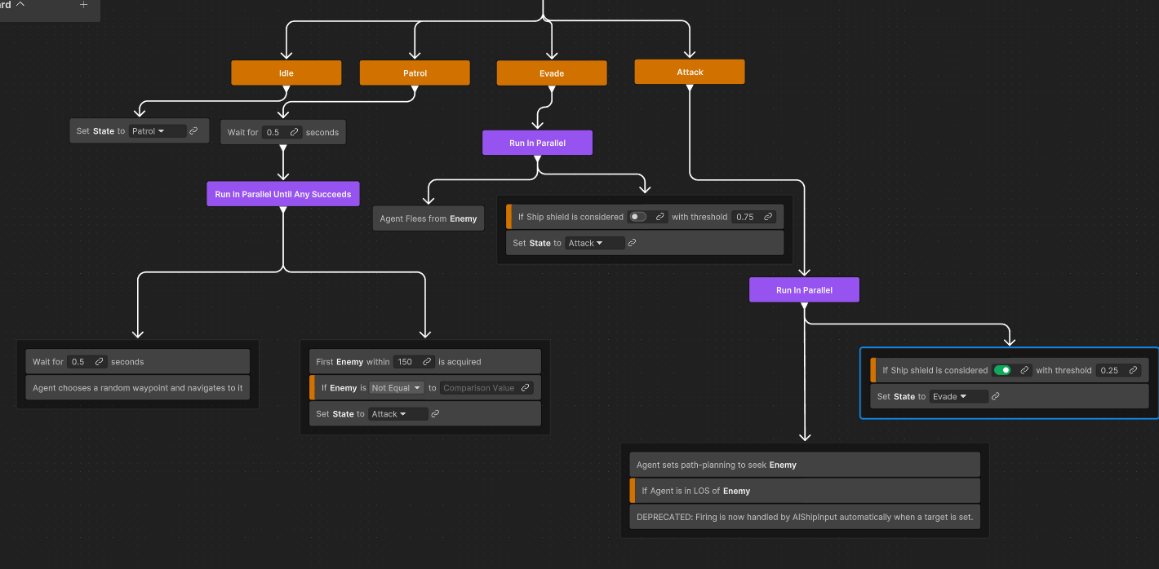
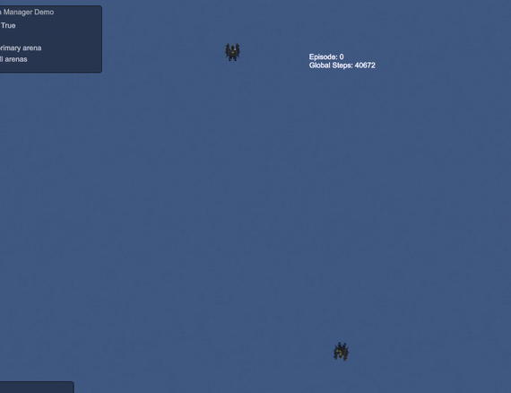
Implementation II
Behavior Tree (Baseline)
States: Idle → Patrol → Evade → Attack
LOS caching & modular actions
Reinforcement Learning (PPO)
20‑float observation: self, enemy, asteroids, bounds
Continuous thrust/strafe/yaw + discrete fire actions
Reward shaping: kill +1, death ‑1, dmg dealt/taken -1 for exiting Arena

Slide 6
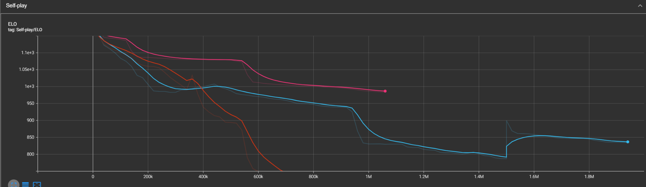
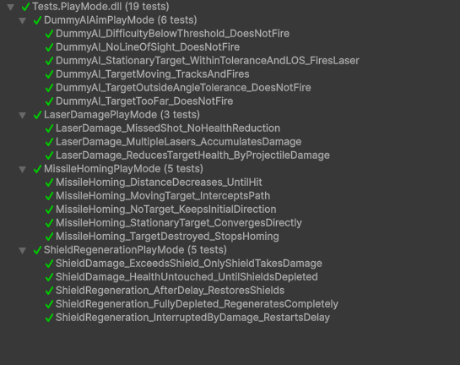
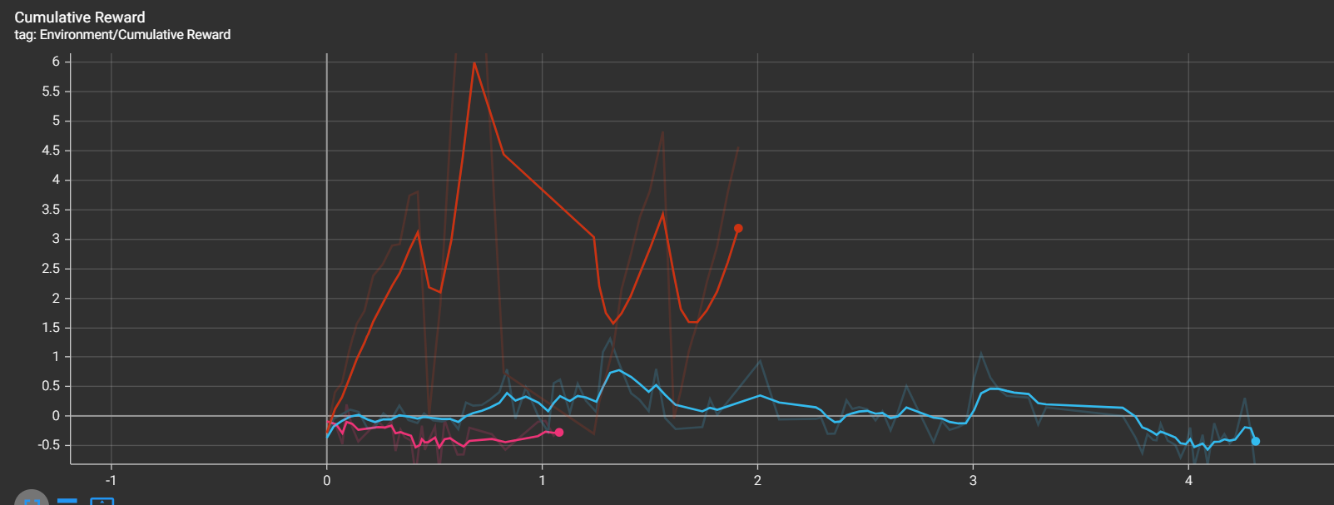
Testing
Validation Tests
Unity PlayMode for weapons, damage, AI
Tensor Board Evaluation and hyper-tuning
(Late Sprint) Automated Win Rate Check
Dummy AI vs RL Pilot

Slide 7
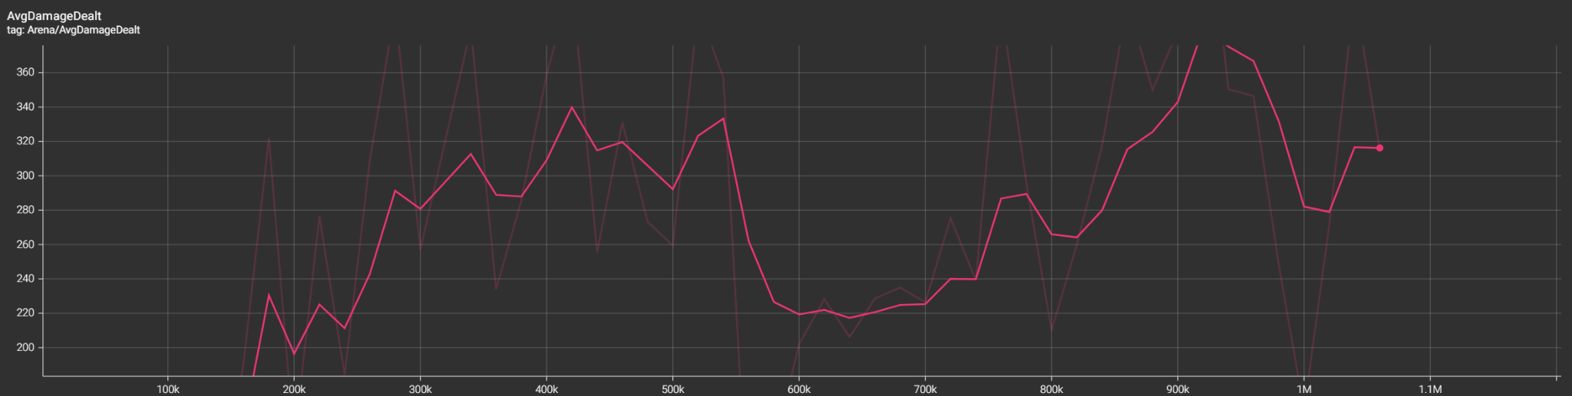
Challenges / What I Learned
ML‑Agents Integration
-Normalized obs, reward balance
-Train early and often
Performance Optimization
Physics batching, object pooling,
Project Management
- order feature implementation by how hard it is to implement/time

Slide 8
Extension
Advanced RL
Self‑play curriculum, hierarchical controllers
Control Systems Applications
Transfer RL pilot to drone sims
Research & Publication
AI believability, training optimization
Career Showcase
Demonstrates Unity, optimization, and RL expertise

Slide 9
Playtest Tutorial
Controls
WASD Move, Right click turn, Left click fire laser, F fire missile
Scenario 1: Dummy AI (1 min)
Scenario 2: RL Agent (1 min)

